Slide 1
Phenomenology
Dr. Alexander Randall 5th

Slide 2
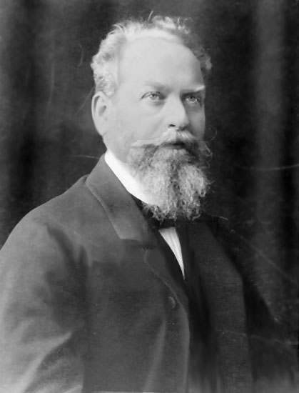
Phenomenology
Philosophical Study of experience and consciousness
Edmund Husserl – 1859-1938
Phenomenology can be roughly described as the sustained attempt to describe experiences and the "things themselves" without metaphysical and theoretical speculations.

Slide 3
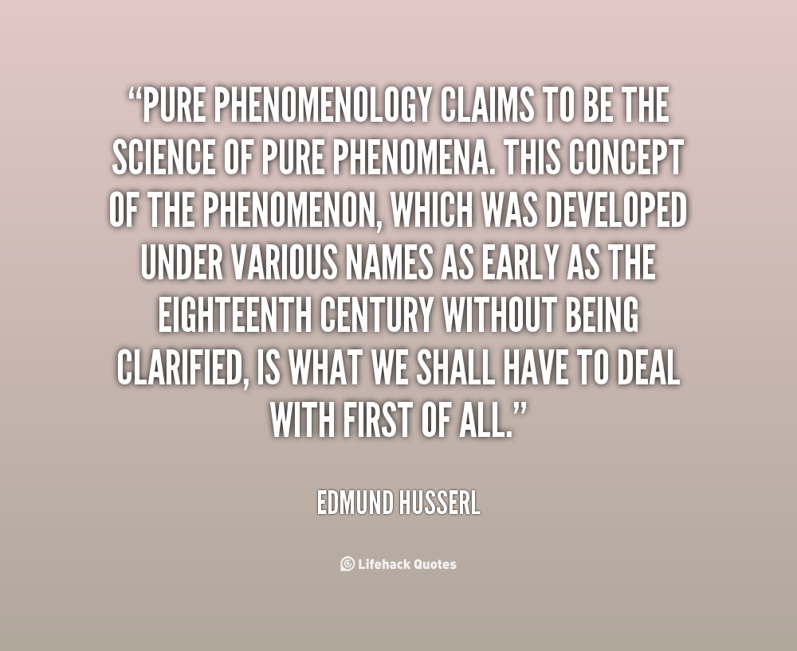
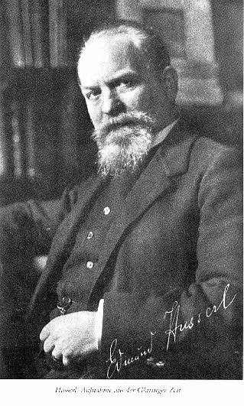

Slide 4
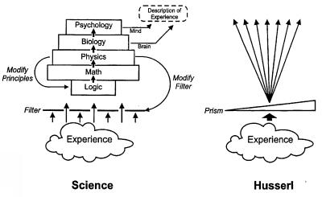

Slide 5
Phenomenology
“A unique and final definition of phenomenology is dangerous and perhaps even paradoxical as it lacks a thematic focus. In fact, it is not a doctrine, nor a philosophical school, but rather a style of thought, a method, an open and ever-renewed experience having different results, and this may disorient anyone wishing to define the meaning of phenomenology”
“Natural objects must be experienced before any theorizing about them can occur.”

Slide 6
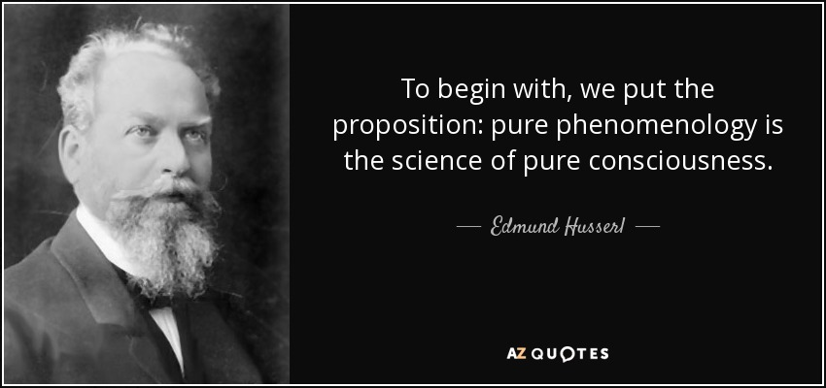
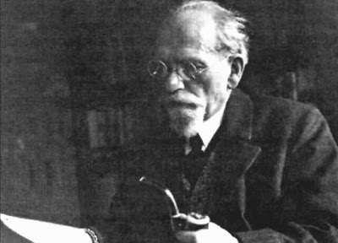
Phenomenology
phenomenology attempts to create conditions for the objective study of topics usually regarded as subjective: consciousness and the content of conscious experiences such as judgments, perceptions, and emotions.

Slide 7
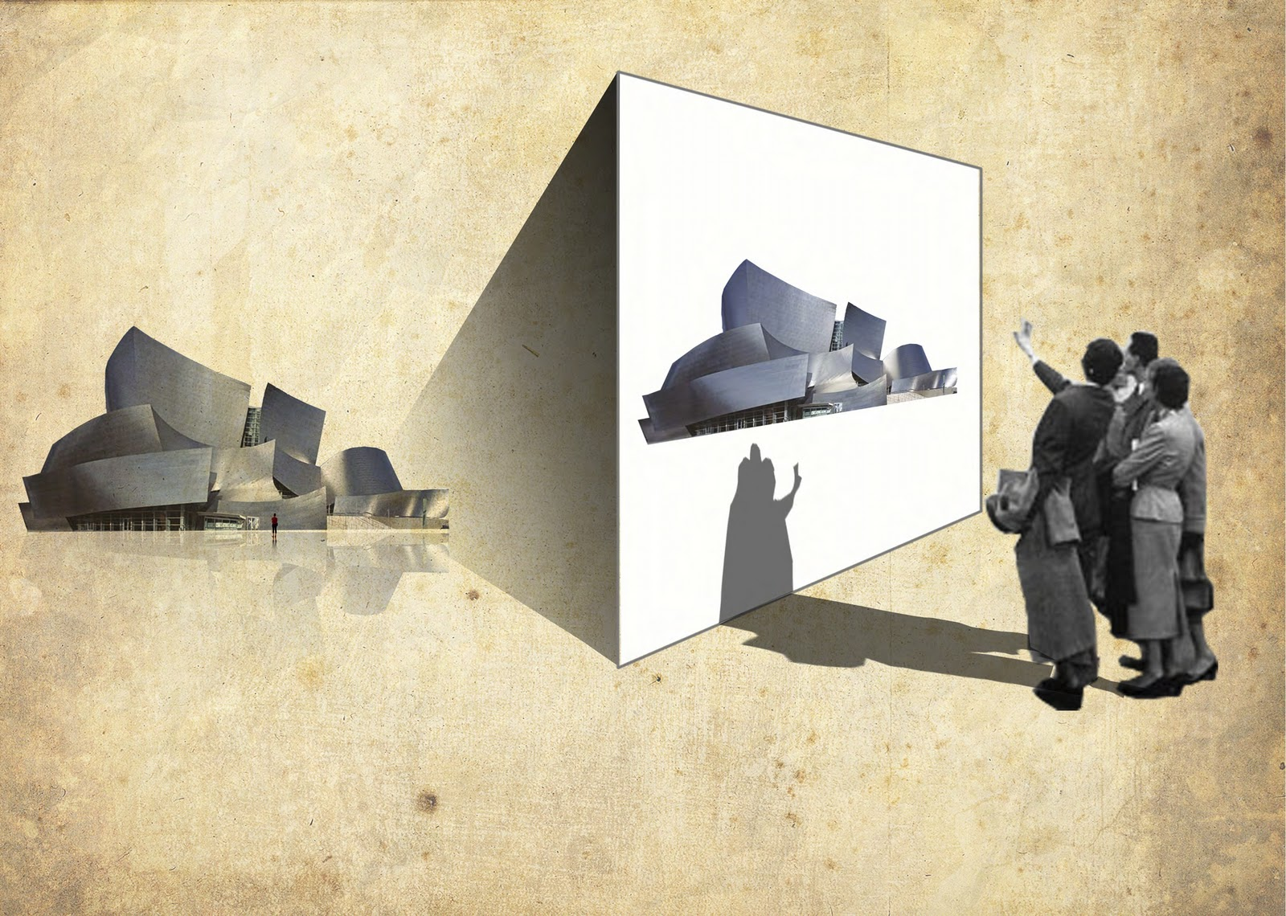

Slide 8
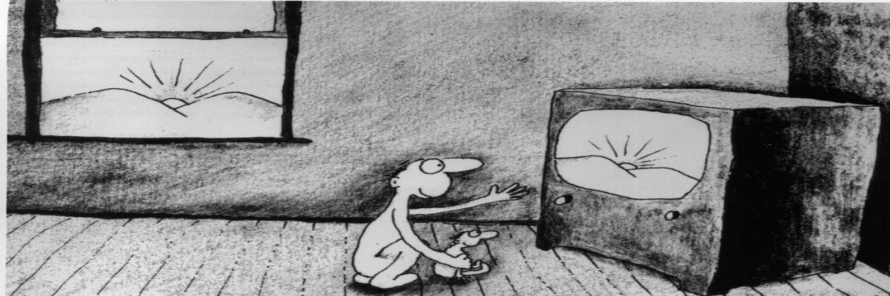

Slide 9



Slide 10
Phenomenology and Dreams
Dream is only available by report.
No direct access by researchers.
Can not be manipulated experimentally
Most research is on Dream form, not content.

Slide 11
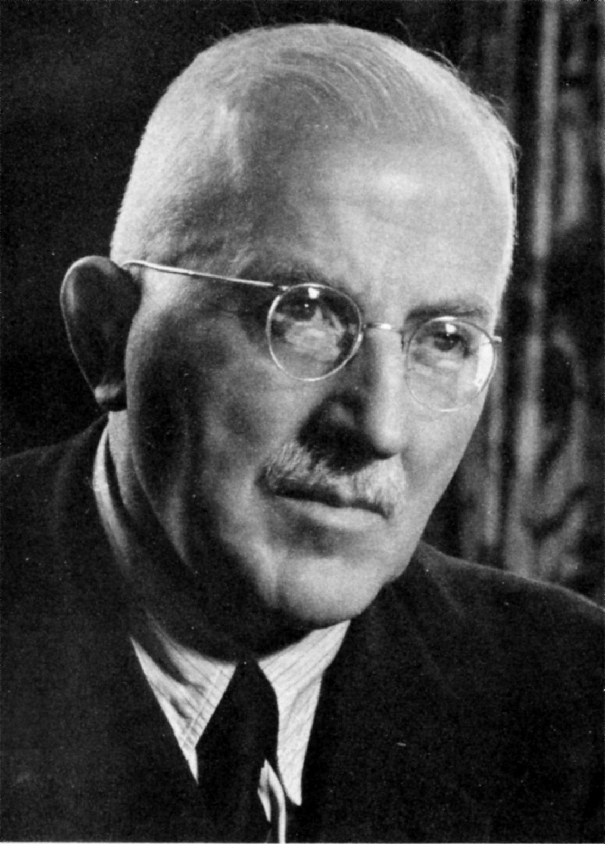
Medard Boss
Not Freud
Not stream of consciousness.
Not free association
The proper study of dreams must be grounded in the dreamers own experience
Rigorous effort to relinquish unnecessary assumptions and prepare suppositions, phenomenology aspires to examine phenomena exactly as they present themselves in conscious experience and thought

Slide 12
Phenomenology of dreams
Why not let the dream be just what it is?
Why not let it speak for itself?
Be suspicious of theoretical conjectures about entities that do not appear in the dream
We understand our daytime experience, why not just understand our nighttime experience
Faith in the power and potential of the manifest dream.

Slide 13
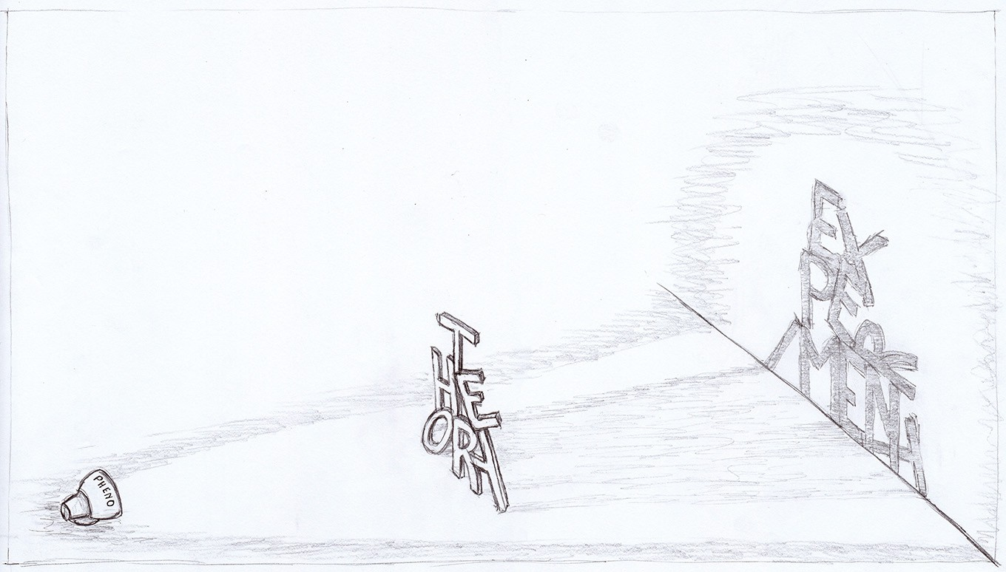

Slide 14
Medard Boss
Boss has helped us to break out of a view of dreams which translated human experience into some other vocabulary.
Behind or beneath human experience, supposedly, there were other forces more truly explanatory of us and of our dreams. For Freud the dream is a result of certain events in energy mechanics,
For Jung, the ancient pagan gods of mythology have their coming and going.
Boss rejects these constructions.
Boss considers only the actual waking life of the dreamer.

Slide 15
Medard Boss
Boss's interpretive concepts are interactional rather than intra-psychic.
Freud, Jung, and others interpret dreams in terms of a subjectivity. Interactions with others result from this internal personality structure.
For Boss, in contrast, humans are the interactional living.
"We are nothing other than receptive, alert world-disclosiveness"

Slide 16
Medard Boss
Boss's main interpretive concepts are themselves powerful, and deserve to be adopted among other concepts as ways of considering a dream.
Boss chiefly uses two concepts:
  how one "bears" oneself toward others, toward the world and life;
  one's as yet unlived "possibilities" of bearing oneself toward life and others.

Slide 17
Medard Boss
Jung’s patient dreamt that the analyst is performing surgery on him. Then an unknown white-haired man appears, cuts two pieces of his own flesh out of himself and grafts them onto the dreamer's abdomen. Thereby the dreamer's life is saved.
Jung’s interpretation: the white-haired man is the "old wise man," a mythological "higher" figure

Slide 18
Medard Boss
Boss rejects this "higher" spiritual dimension, as well as the dreamer's experience of being helped, and saved.
Boss's says:. . . the possibility of being a masculine, mature, selfless helpful fellow-man dawns upon him while dreaming. The reason why the good dream-man is unknown might lie in the fact that this most mature way of being a human being is still very unfamiliar to the dreamer. . . . this possibility for bearing himself in the world could only appear as a stranger.

Slide 19
Medard Boss
Boss: dream interpretations are free floating. They have no phenomenological ground.
Equally good alternatives could be multiplied.
The patient's supposed "passive" bearing. (the patient is passive in surgery.)
But surgery can also be said to be painful, bloody, unusual, expensive, dangerous, usually done by men, and constituting an emergency.
The grafting of the flesh is a magical solution, perhaps, or a bloody one, or a guilt-provoking one. Any of these things might be said.

