Slide 1
Dream Interview of
Gayle Delaney
Dr. Alexander Randall 5th

Slide 2




Gayle Delaney – Princeton 1972
http://yoursleepinggenius.com/

Slide 3
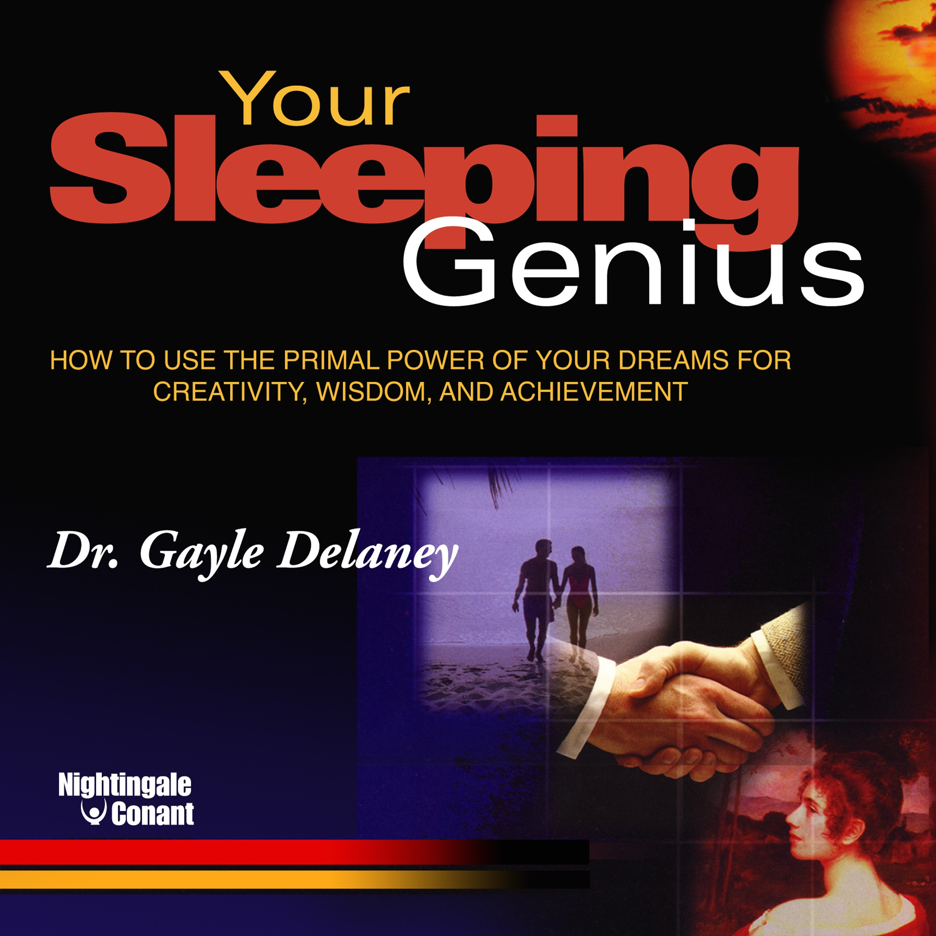


Slide 4
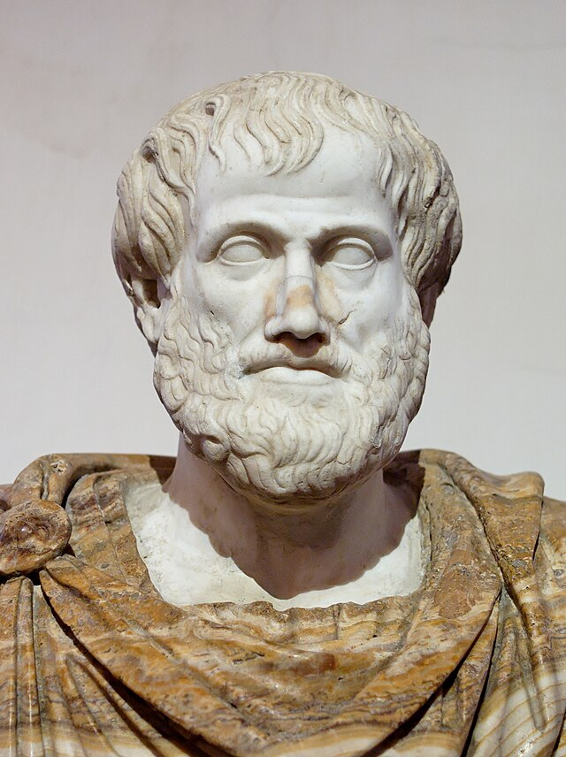
Aristotle said “the most skillful interpreter of dreams is he who has the faculty of observing resemblances”

Slide 5
Basic Assumptions
dreams are expressions of feelings, thoughts and ideas which are usually out of the dreamer’s waking awareness, and which when brought into full awareness enhance the dreamer’s life

Slide 6
Basic Assumptions
The effect of almost all recalled dreams is greatly enhanced by waking efforts to understand the dream in the context of the dreamer’s life.

Slide 7
Basic Assumptions
Dreams have a point, a message intended to be grasped by the waking mind and used for the benefit of the dreamer - get the message. Get the Point!

Slide 8
Basic Assumptions
the dreamer, upon awakening, has all the information necessary to understand the dream - the role is interviewer, facilitator, not interpreter, not symbolic substitution

Slide 9
Basic Assumptions
the cause and source of dreams is still unknown
dreams serve many functions

Slide 10
Goal
The goal of the method is to assist the dreamer in getting the point, the punchline of the dream, with as few interpretations or explanations from the interviewer as possible.

Slide 11

Curious
Interviewers are most effective when they wear a curious facial expression and bend their efforts to devise a question that will draw out the dreamer’s thoughts.

Slide 12
From another Planet
The interviewer asks the dreamer to pretend that the interviewer comes from another planet. Assume the role of someone from another planet.
The interviewer pretends to have little or no understanding or knowledge of objects, places and people found on planet Earth. This allows the interviewer to get at the most pertinent information quickly with a minimum of defensiveness on the part of the dreamer and with minimal intrusion and distortion on the part of the interpreter.

Slide 13
The Method:
Tell the dream story in the first-person present tense and with the feelings. Reenter the dream.
Overview the feelings, ask the major moods and feelings of the dream, doesn’t remind you of anything in daytime life.

Slide 14
Elicit adequate definitions and descriptions, seek clarity
  What is the setting, describe each context. Defined describe. I’m from another planet what is…
  Describe the feelings at various moments in the dream
  Describe the people as if I had never heard of that person before. Elicit a fresh description in the context of the current dream
  Describe every object as if I’d never seen one before.
  Describe the action and plot, ask about the major action of the dream.

Slide 15
Condense and recapitulate the dream, repeated verbatim or condensed or distilled mirroring the dreamer’s response using the dreamer’s words
Create a bridge to waking life
“does this remind you of anything or anyone your life”, or “have you ever felt this way”,
Or “what is this like in your life.”
Avoid interpretations, avoid symbolic substitution.

Slide 16
Create a summary. All the images have been explored, ask the dreamer to retell the dream.
Dreamer and interviewer discuss which images in the dream lend themselves to fruitful reflection.
The dreamer is almost always has to reread the dream and any interpretive notes two or three times during the week

Slide 17
Cue Card
1) What are the feelings you are most aware of in the dream? Do they remind you of anything in your current life?
2) Describe the opening settings of the dream, place, mood, feelings
3) What does XXX remind you of anything?
4) Who is X, for each person in the dream. Describe them. Do not ask what does X mean
5) What is X like in waking life
6) What is X like in your dream? What is X doing in your dream
7) Does X remind you of anything in your life
8) Does X whom you described as (recapitulate), remind you of anyone in your life or to some part of you which is like X
9) When dreamer bridges from dream back to real life, ask how so

Slide 18
Cue Card
10) What is Z for each object in the dream, do you like Y, do you own, eat, wear or enjoy Z? Why or why not? What kinds of people have Z?
11) What is the Z in your dream like - how would you describe white to someone from another planet? Do you think – Z’s are wonderful, silly, necessary, or creepy
does the Z in your dream which you describe as (recapitulate), remind you of anything in your life?
13) How so?
14) How do you feel at this moment in the dream
15) Tell me more about this feeling
16) Tell me about a time or the last time you felt this way
17) Does this feeling (recapitulate the description) remind of anything in her current life

Slide 19
18) Describe the major action or events in the dream
19) Recapitulate all the dreamer’s descriptions
20) So in this part of the dream (this happened) which you describe as… Which remind you of… Then… Does all this remind you of anything? Even when the metaphor is obvious to the interpreter, it is important to resist the temptation to provide the interpretation?
21) Now how do you understand your dream? Tell me the whole dream, adding the bridges and commenting on what you understand and what remains unclear. Remember leave interpretations to the dreamer

Slide 20
Core Concept
1) Reenter the dream
2) Explore and appreciate the vivid essential reality of the images
3) Bridge these experiences to one in waking life in useful meaningful manner

