Slide 1
Dream technique of
Montague Ullman
Dr. Alexander Randall 5th

Slide 2
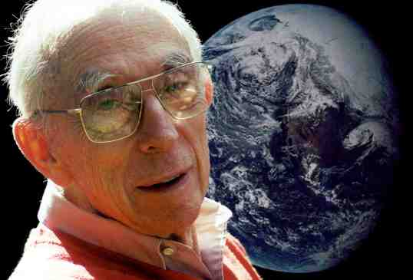
By Way of Introduction
Monty Ullman
Psychiatrist – Post Freudian
Dream appreciation, not Interpretation
Everyone can do it.
Based at Maimonides Hospital Dream Lab

Slide 3

Dream Telepathy
The classic study of Dream Telepathy
Lab study
Folks sleep with EEG
Staff wakes them after each REM Period
Elsewhere a team member focuses on 1 of 6 pictures all night.
In the morning:
Judges read the dreams and look at 6 pictures and pick…
Which one was the team member looking at?
Does it appear in the dreams?
Ullman came to Randall’s Doctoral Thesis Presentation.
“Dream Telepathy in Field Setting”

Slide 4
Key Concepts
Waking language is a way of categorizing reality
Dreams are in pictorial figurative language using metaphors.
Visual metaphors
Emotionally Nude

Slide 5
Key Concepts
When looking at a dream with daytime eyes we are blind to our own images
When we share the dream it becomes a social experience
Dreams in the present, may evoke childhood memories
Sharing may release us from what was secret or burdensome.

Slide 6
Ullman’s Dream Technique - RULES
Sharing the dream is voluntary
Dreamer determines the level of self-disclosure
Dreamer can stop the process at any point
Dreams are communication to oneself
Dreamer has to be ready to confront (or resolve) the issue being dreamt about.

Slide 7
Ullman’s Dream Technique – Method
Share the dream with the group.
  Best to use short recent dreams
Speak slowly so others can take notes.
Tell the dream - not your interpretation
Stick to manifest content
Including any feelings

Slide 8
Ullman’s Dream Technique – Method
Bizarre and illogical sequences must be accepted as such
Sometimes simply sharing produces a burst of insight. Aha!

Slide 9
Ullman Group Work
Group members make the dream their own - - speak as if it is your own
  “If I had a ____ in my dream it might mean_____”
Discussion is directed toward the GROUP, not the dreamer.
Explore the metaphors, puns, analogies, figures of speech
Project your own meanings into the dream
Seek the largest number of possible projections – quantity!

Slide 10
Ullman Group – Closure
Invite the dreamer to respond:
What was meaningful
  “When you said____ It made me think ____.”
Dreamer is free. Go where ever the dream leads.
Open a dialogue if group members have questions
Goal: seek a sense of closure, look for AHA!

Slide 11
GOAL: Aha!

