Slide 1
Gestalt Therapy of
Fritz Perls
Dr. alexander Randall 5th
Professor of communication

Slide 2
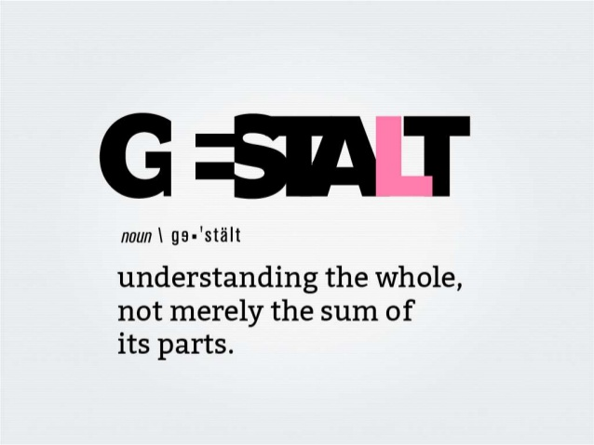
Gestalt Psychology

Slide 3
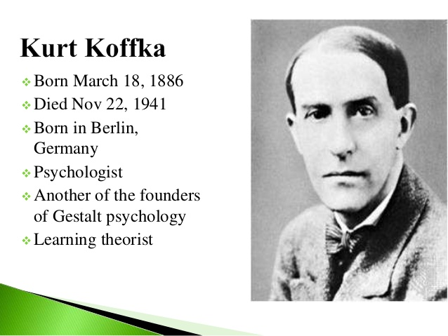
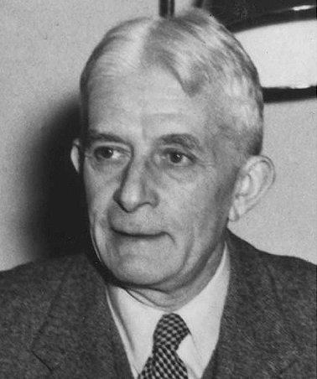
Wolfgang Kohler

Slide 4
Gestalt Theory
Gestalt psychology or gestaltism (German: Gestalt [ɡəˈʃtalt] "shape, form") is a theory of mind of the Berlin School of experimental psychology. Gestalt psychology tries to understand the laws of our ability to acquire and maintain meaningful perceptions in an apparently chaotic world. The central principle of gestalt psychology is that the mind forms a global whole with self-organizing tendencies.

Slide 5
"The whole is other than the sum of the parts"
This principle maintains that when the human mind’s perceptual system forms a percept or gestalt, the whole has a reality of its own, independent of the parts. The original famous phrase of Gestalt psychologist Kurt Koffka, "The whole is other than the sum of the parts" is often incorrectly translated as "The whole is greater than the sum of its parts," and thus used when explaining gestalt theory, and further incorrectly applied to systems theory. Koffka did not like the translation. He firmly corrected students who replaced "other" with "greater". "This is not a principle of addition" he said. The whole has an independent existence.

Slide 6
In the domain of perception, Gestalt psychologists stipulate that perceptions are the products of complex interactions among various stimuli. Contrary to the behaviorist approach to focusing on stimulus and response, gestalt psychologists sought to understand the organization of cognitive processes. The gestalt effect is the capability of our brain to generate whole forms, particularly with respect to the visual recognition of global figures instead of just collections of simpler and unrelated elements (points, lines, curves...).
In psychology, gestaltism is often opposed to structuralism. Gestalt theory allows for the deconstruction of the whole situation into its elements, what it really is.

Slide 7
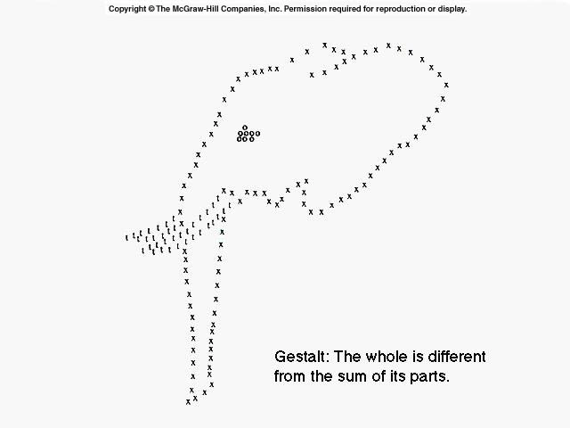

Slide 8
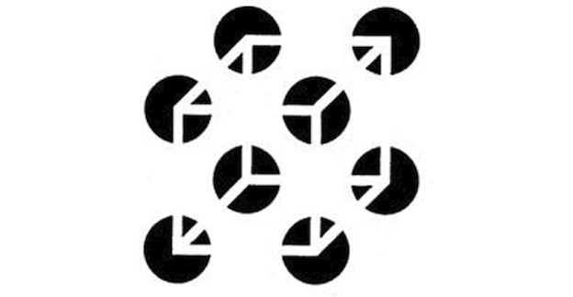

Slide 9
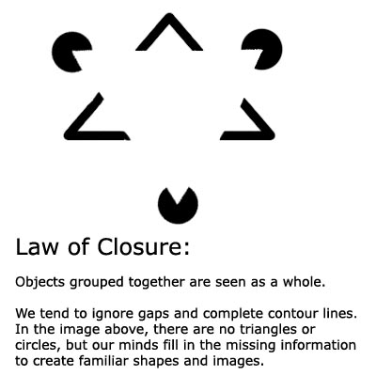

Slide 10
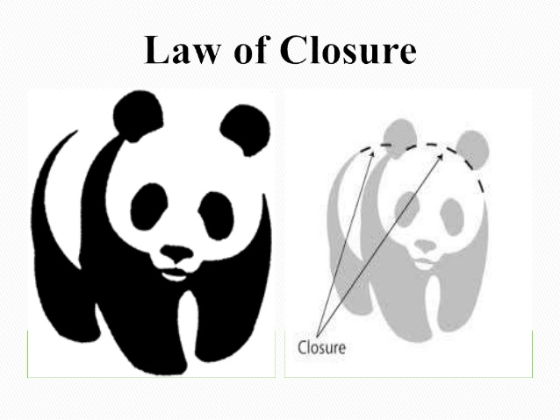

Slide 11
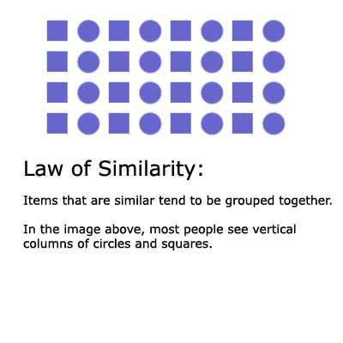

Slide 12
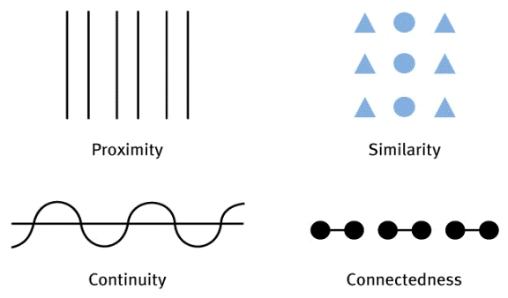

Slide 13
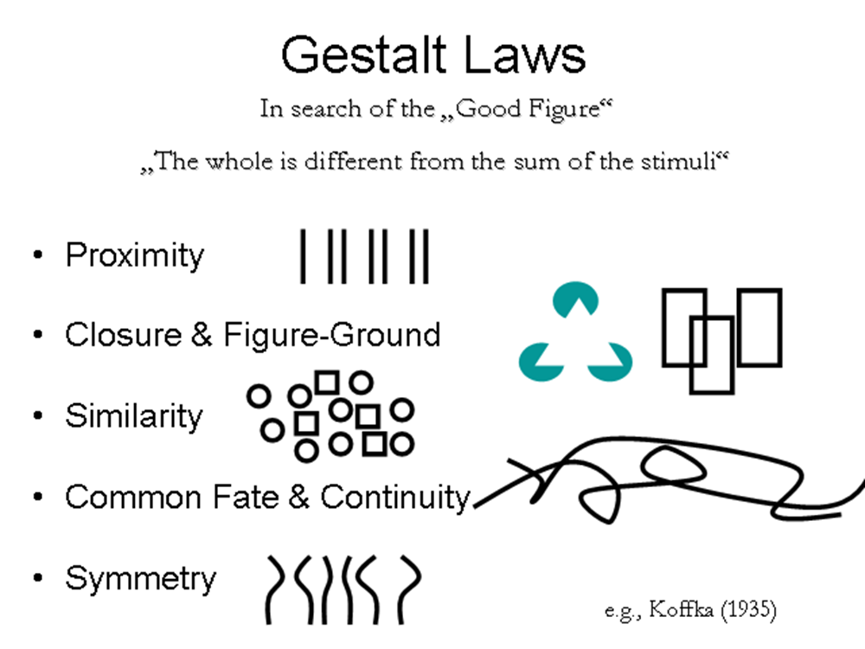

Slide 14
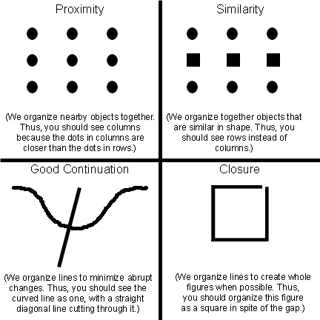

Slide 15
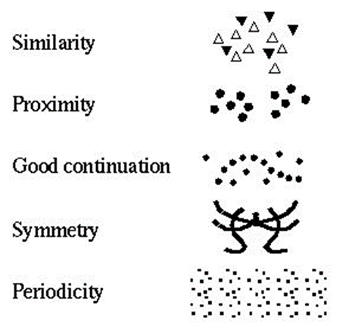

Slide 16
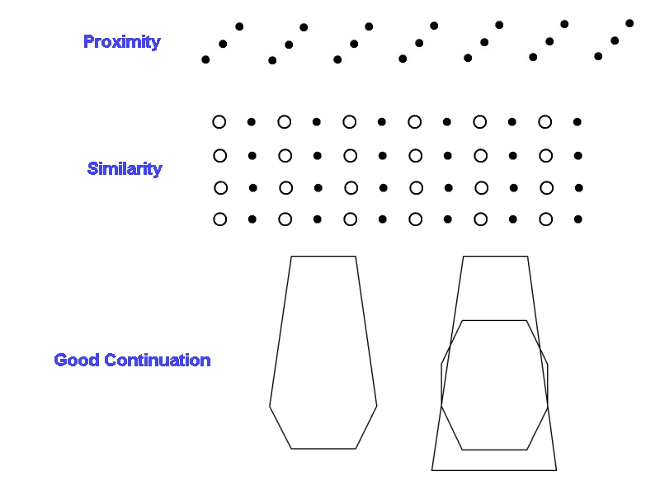

Slide 17
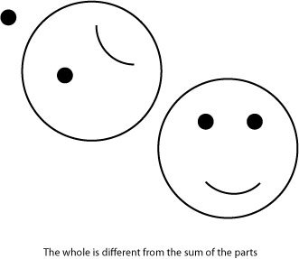

Slide 18
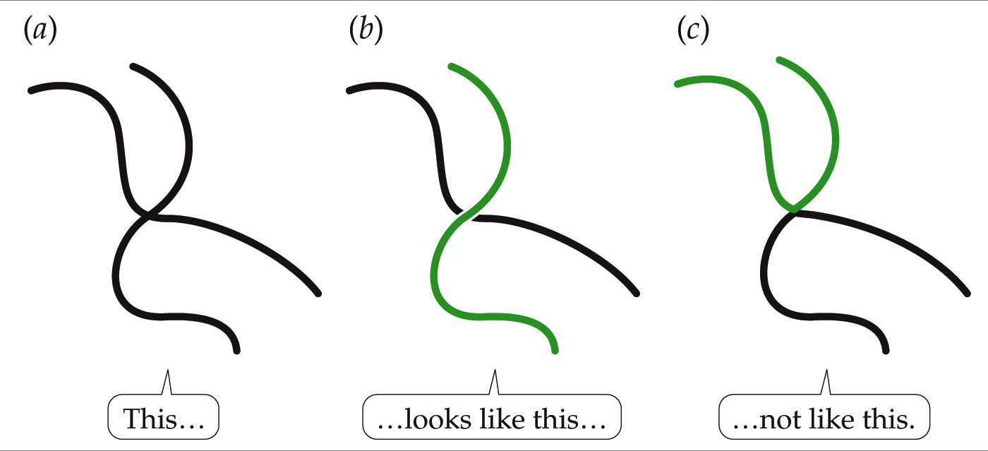

Slide 19
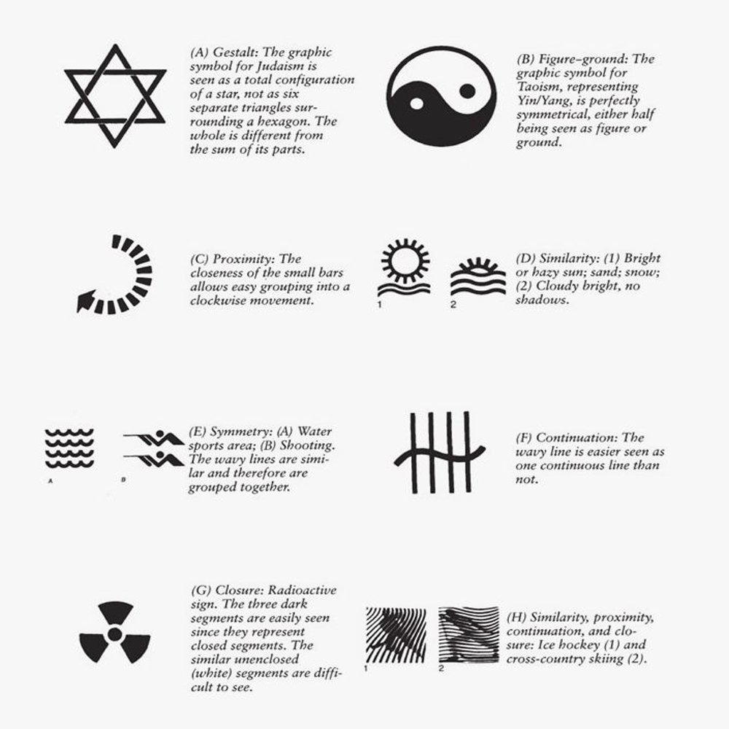


Slide 20
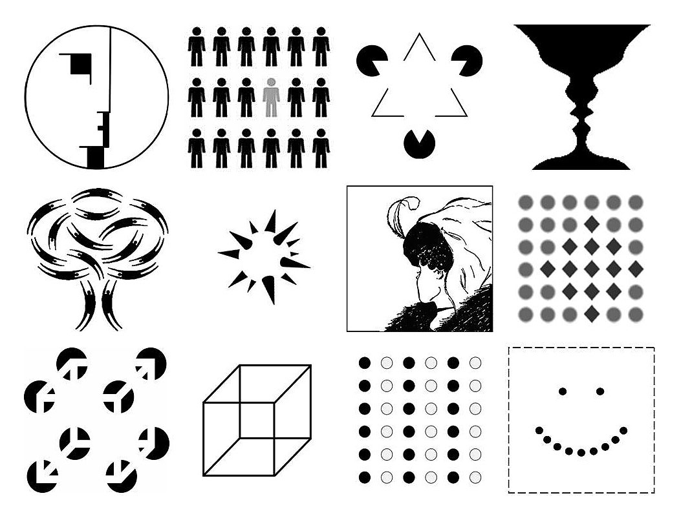

Slide 21

Figure and ground (Background)
We form wholes out of data
Man is a meaning making animal
Figures form in a process
A clear figure is formed on the basis of need
A clear figure leads to need satisfaction
Truth is emergent
The formation of a clean figure or gestalt is the cure.

Slide 22
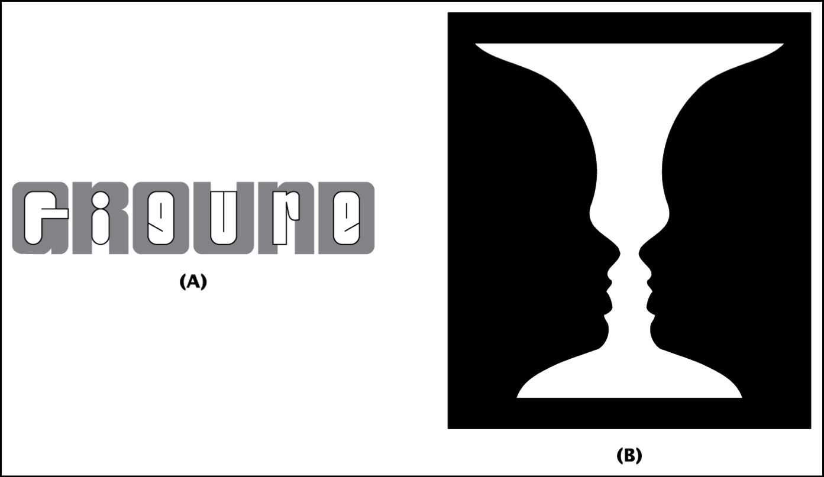
Figure and ground (Background)

Slide 23
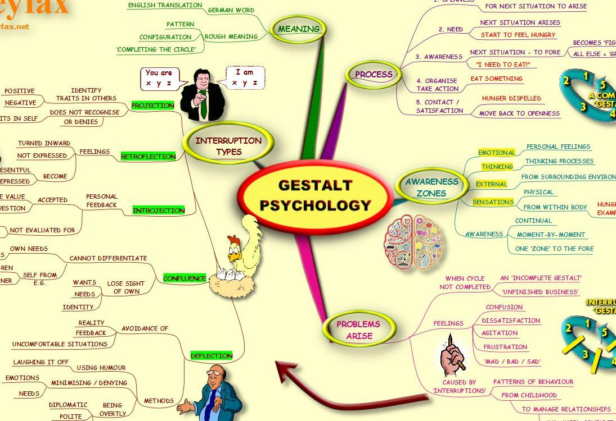

Slide 24
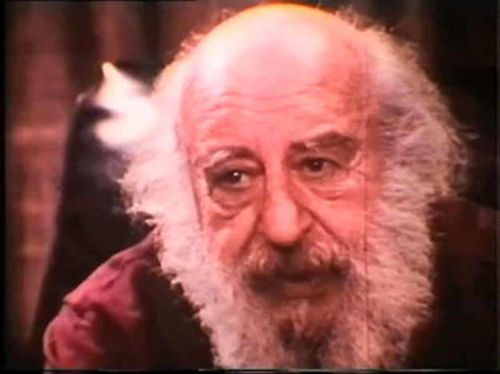
Fritz Perls
Gestalt Therapy

Slide 25
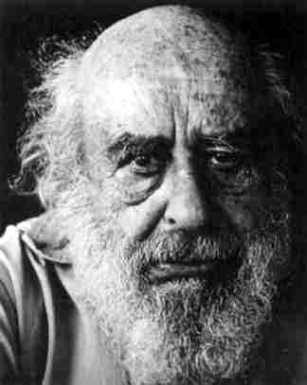
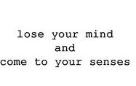


Slide 26
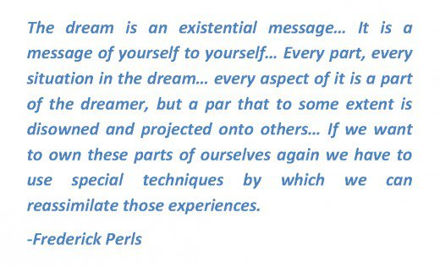

Slide 27
Gestalt Therapy Dream Principles
Own the Dream
Each Character is a part of yourself
Each trying to be part of the whole
Reassemble the whole
Re-live the dream
What are you feeling right now?
Discuss incongruencies
Talk to each part
Discussion with the characters
Empty Seat - Hot Seat – Two chair technique.

Slide 28
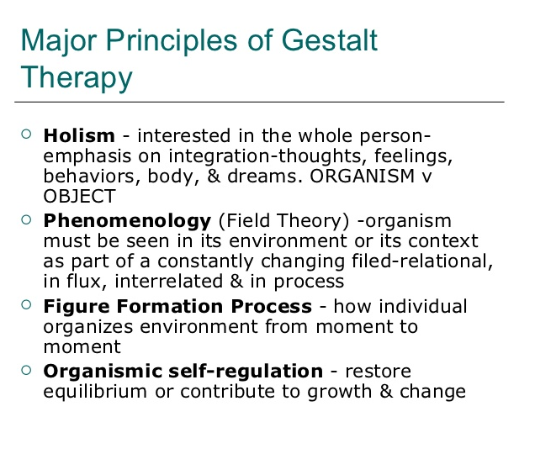

Slide 29
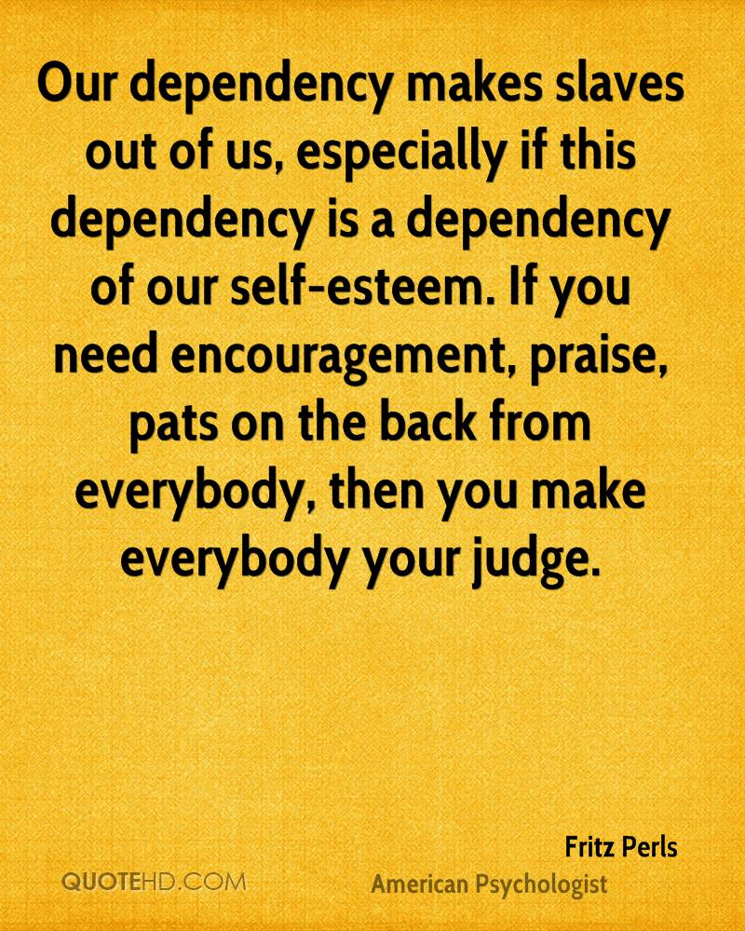
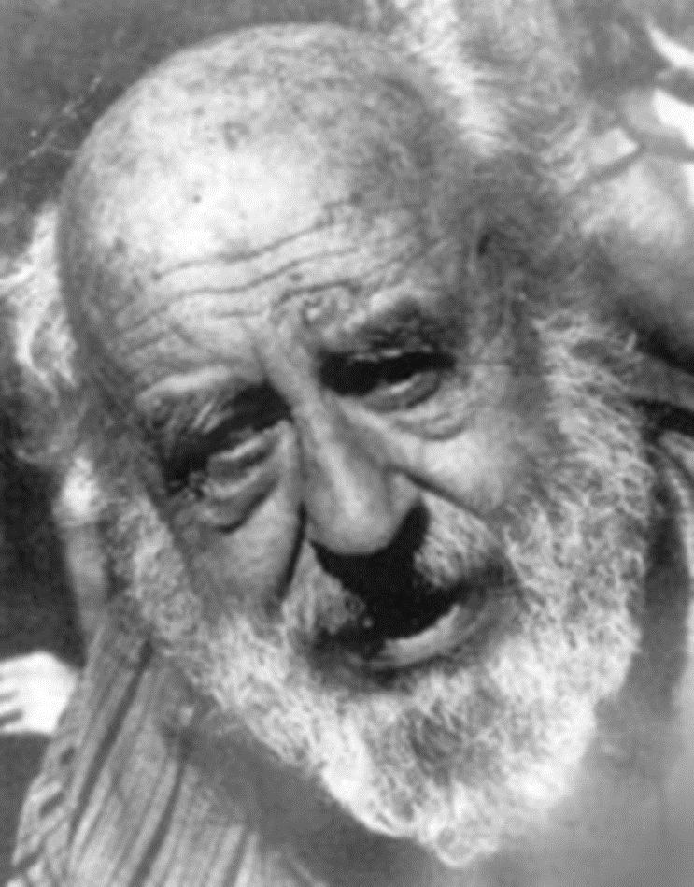

Slide 30
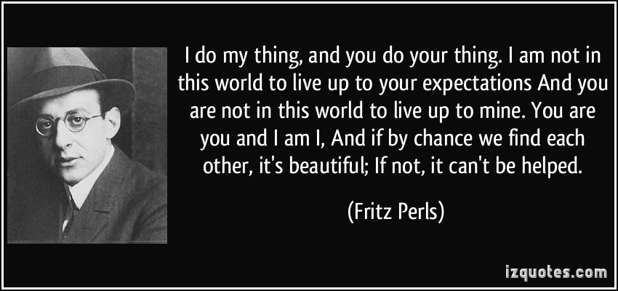

Slide 31
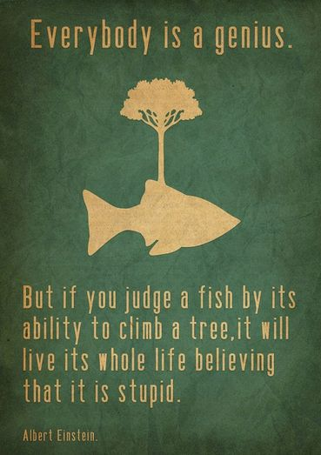

Slide 32


