Slide 1

Dreams and the
Spirit
Dr. Alexander Randall 5th
Professor of Digital Media Communication

Slide 2
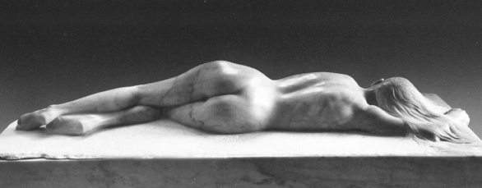
You will spend 22 years of your life asleep

Slide 3
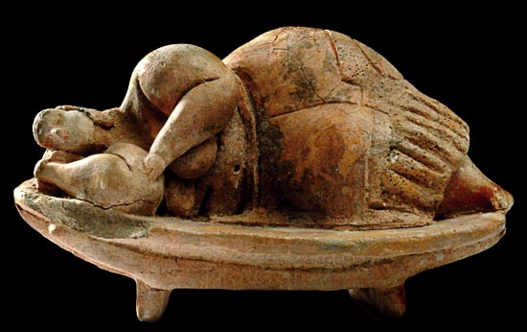
You will spend 8 years of your life Dreaming

Slide 4
No Choice.
It’s Mandatory!
Your body insists !!

Slide 5
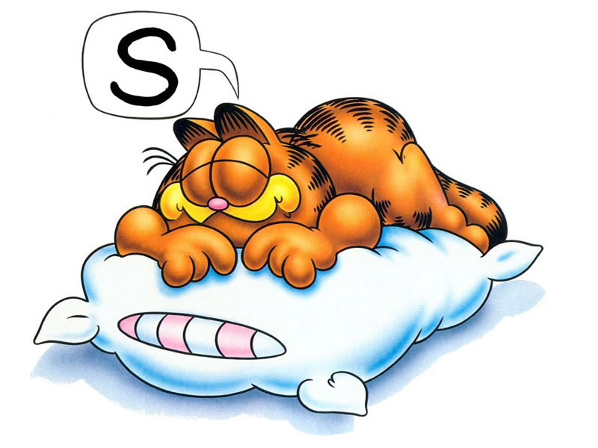
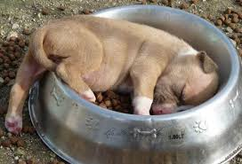
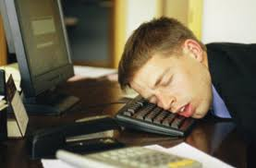
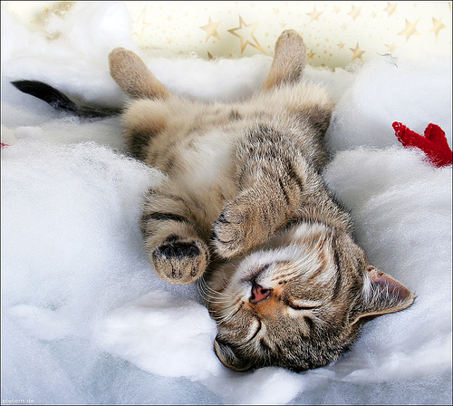
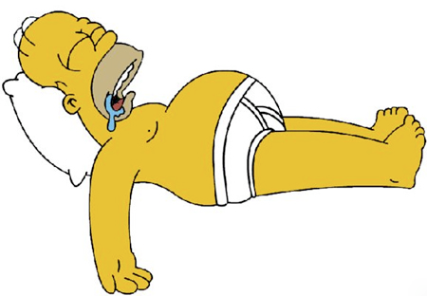
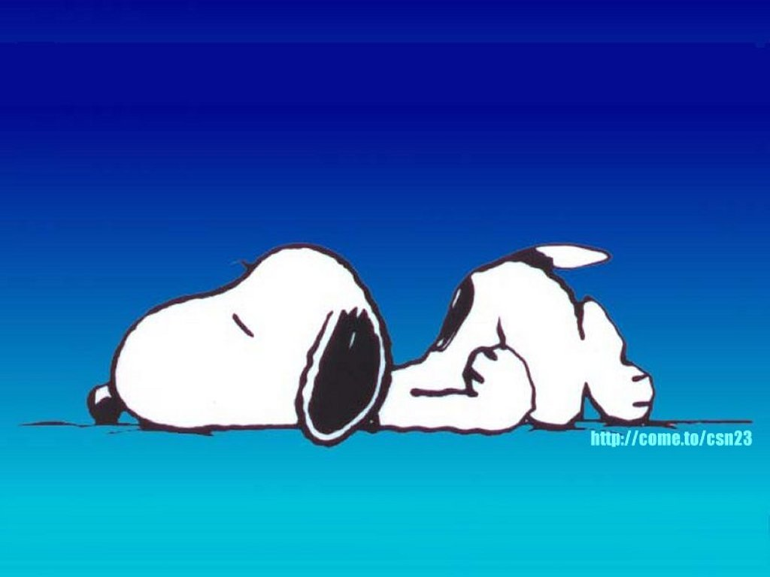
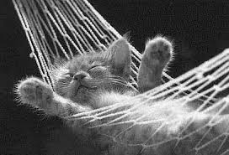
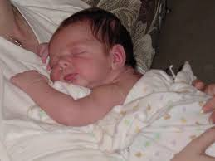

Slide 6
Every Single person...
- all over earth,
- all human history…
All Sleep !
All Dream !

Slide 7
1/3 of your life in sleep…

Slide 8
1/3 of your life in sleep…
How many college classes do we have on sleep?

Slide 9
1/3 of your life in sleep…
How many college classes do we have on sleep?
None.

Slide 10
How many of you…?
Record 4-5 dreams every night?
Record one or two dreams every night?
Record a dream every few days
How many have a dream journal beside the bed?
How many remember a dream every few days?
Remember a dream a few times a year?
Haven’t remembered a dream in a long time?

Slide 11
Homework!
Start a notebook.
In the evening – download the day. Get rid of it!
Draw a line. Start the new day as you go to sleep

Slide 12
Homework!
Start a notebook.
In the evening – download the day. Get rid of it!
Draw a line. Start the new day as you go to sleep
As you lie in bed, think about your dreams.
On waking, wake gently, hold your position.
Write SOMETHING in the journal - NO MATTER WHAT!

Slide 13
Let’s Look more deeply...
At Work

Slide 14
Let’s Look more deeply...
At Work
At Home with Family

Slide 15
Let’s Look more deeply...
At Work
At Home with Family
Asleep and Dreaming

Slide 16
Let’s Look more deeply...
At Work
At Home with Family
Asleep and Dreaming
We devote most of College to 1/3 of life

Slide 17
Let’s Look more deeply...
Who is teaching the other 2/3?
At Work
At Home with Family
Asleep and Dreaming

Slide 18

No One

Slide 19
Every culture has stories about Dreaming

Slide 20
Every culture regards dreams as special messages…

Slide 21
The Spirit Spouse is one of the most widespread elements of shamanism, distributed through all continents and at all cultural levels. Spirit husbands/wives are the primary helping spirits of the shaman, who assist them in their work, and help them gain power in the world of spirit.

Slide 22


Slide 23
-From God…
-From Ancestors…
-From the “other” world…

Slide 24
Dreams may be WHY we have theories about another world…

Slide 25

Spirit Guide

Slide 26
Dreams in the Bible… (Christ Birth)
Dreams in the Koran… (interpretations)
Dreams in the Book of Mormon
Tibetan Yogas of Dream and Sleep

Slide 27
`
Your sons and your daughters shall prophesy, your old men shall dream dreams, your young men shall see visions.
Joel 2:28

Slide 28
The Divine speaks through Dreams.
Dreams come from the spirit world.

Slide 29
Dreaming may be a residual of the most primitive form of thought…

Slide 30
Benjamin Whorf:
“Language constrains thought...”
Without a word, you don’t have that thought…”

Slide 31
Remember the world before:
Selfie, carbon footprint, unfriend 2010

Slide 32
Remember the world before:
Selfie, carbon footprint, unfriend 2010
Nuanced, Hands-on, Air conditioned 1920

Slide 33
Remember the world before:
Selfie, carbon footprint, unfriend 2010
Nuanced, Hands-on, Air conditioned 1920
“Love” “Peace” and “logic” (antiquity)

Slide 34
How did CAVE people think?
How did people think when language was limited to a few dozen words?

Slide 35
“Cave Thought” must have been a lot more like dreams…
Images, scenes, events.

Slide 36
Dreams of :
- A dead relative…
- Flying through the air…
- Monsters chasing you…

Slide 37
Dreams of :
- A dead relative…
How did the ancients think about the dead relative coming at night and meeting/speaking with them...?

Slide 38
Dreams of :
- Flying through the air…
We have all flown....

Slide 39
Dreams of :
- Flying through the air…
We have all flown....
Our parents flew us around when we were infants. Every time we were carried

Slide 40

Deep in our primitive mind are all kinds of invisible spirits who came to us at night…

Slide 41

Maybe this is why we have so many stories from all over the world about the “other world”
Spirits
Angels
Ancient Gods
Living After Death
Spirits coming to our aid
Wise Ancestors
Evil spirits coming to hurt us…

Slide 42


Slide 43
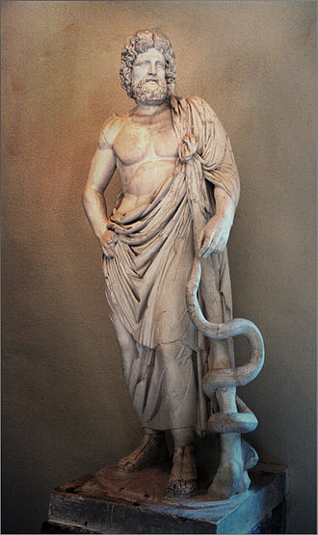
Æsculapius
Ancient Greek Demi-God – Roman God...
More Temples than to any other Greek God
His daughters – Hygeia and Panacea
Pilgrims come with illness
Wait outside…. Cleanse body, purify mind
Walk around temple
Read the stones attesting to cures

Slide 44
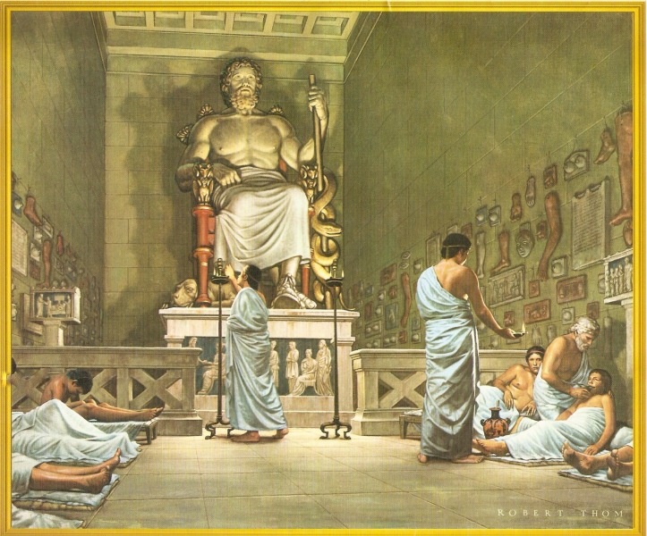
Æsculapius
When you are prepared
  The priest calls you into temple
  Sleep on the Kline
  The God visits in the night
  and speaks to you
In the morning :
  The priest listens to the dream
  Interprets the meaning
  Diagnosis
  Issues a Rx

Slide 45
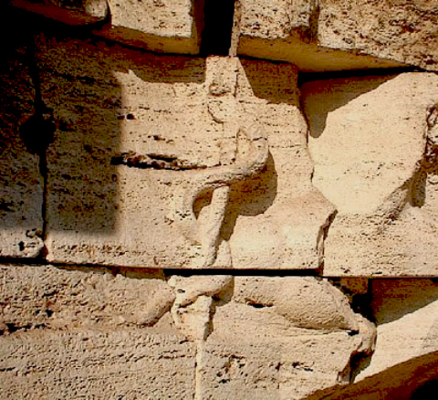
Æsculapius
Prototype of the Medical Doctor
and the Pharmacist.
Aesculapius = healing through dreaming.
Modern version is called Dream Incubation.
Pose a problem to the dream mind and seek a solution

Slide 46
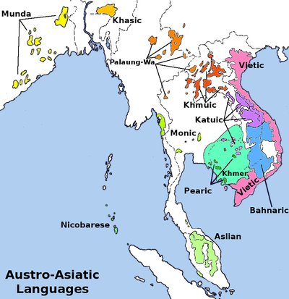
Temiar Senoi
Tribe of Orang Asli in The Cameron Highlands of Malaysia
Culture Built around dreaming
Everyone shares dreams every morning.
Dreams call for Action.
Dreams provide Guidance
Children learn a technology of dreaming.
Not control –
Using dreams as guides to live

Slide 47
Temiar Senoi Principles
Seek awareness in dreams.
Seek pleasure in dreams. It's OK!
Spirits can reveal the future, but not with certainty.
Falling isn't bad; a spirit is calling you.
Confront your enemy, with firm love.
Call on your friends to help.
Death is OK. It is just a transition to another place
Seek your dreams in the "real world."

Slide 48
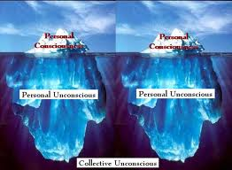
C.G. Jung
Your dreams come from your deepest unconscious – It is trying to tell you...
Personal Unconscious and Collective Unconscious
Archetypes reside in Collective Unconscious
Express themselves with familiar faces.
Archetypes:
  Wise old Man
  Mother Earth
  Hero
  Trickster

Slide 49


Slide 50
How to remember more Dreams
Notebook beside bed
Wake with eyes closed
Review dream before you open eyes
Write something every morning
Review notes in daytime
Think about dreams as you are going to sleep
Take action based on dream in the waking world.

Slide 51
How to remember more Dreams
Remember, Dreaming is easy.
You practice every night.
The core idea is to pay attention to your dream mind and nurture it.
While awake, think about your dreams.
While going to sleep, focus on dreaming.
Upon waking, pay attention to your dream. That's important - exercise.
You create your own ritual of morning dream remembering.
Anyone will work.

Slide 52
How to remember more Dreams
Tailor fit it to your existing morning routine.
I use a notebook beside the bed.
Get up and focus on a symbol on the wall.
Stare at the ceiling and recite the dream into a tape recorder.
Talk with a regular morning companion who will share dreams
Still others go to the computer and write it down and e-mail it me.

Slide 53
How to remember more Dreams
Make a Garage for your dreams – a place where they belong
If you'd don't have a garage for your dreams, Where will they park?
Dream notebook or journal.
Ritualized writing my dreams.
Every morning write before doing anything else.
When I am in top "Olympic" dream form, I record five or six dreams a night.

Slide 54
How to remember more Dreams
As you lie in bed going to sleep, think about dreams.
Think of previous dream images you have liked.
Avoid guilt trips or telling yourself you "should" dream.
A special dozing posture can boost re-minding yourself to dream.
I stack pillows under my knees. I don't go to sleep in that position, but I enter a borderline state and hover there before rolling over going-to-sleep-position.
In the boarderline state you can allow your mind to wander.
Allow it to create a dream. Let go. Stop giving directions.

Slide 55
How to remember more Dreams
Wake as gently as possible
Rise from dreaming when the dream is over, not when an outside alarm wakes you.
Wake with eyes closed – that takes practice
Hold still for a few minutes and focus attention on what your mind has seen and heard during the preceding time.
Dream memories are fragile and seem stored in your body's position.
Hover on the brink...Review the contents.
If you must have an alarm, use two alarm clocks; set one for the time you must wake and set the other 30 to 45 minutes earlier. You can wake to the first alarm, then doze and dream until the second tells you it is time to wake up.

Slide 56
How to remember more Dreams
If you don't recall a dream right away, relax and let your mind wander.
Allow any image to lead you to other images, follow the train of images.
Let your body Re-mind you.
Try your going-to-sleep position or the one you use to hover before going to sleep.
It helps to be a little detached.
If I get some dreams, it is OK and if I don't that is OK too.
Nurture any image you get and see what it leads to...
Still nothing? That's OK, you get to dream again tonight!
Pay attention during the day. Something you see may Re-mind you of the dream.

Slide 57
How to remember more Dreams
Share your dreams with other's who will regard them with favor.
Don't share with someone who makes fun of dreaming,
Share with other people who will support you and ask about your dreams.
Every sharing helps.
The dreaming mind is delighted by attention paid to it.
When you explore your dreams and the symbols and metaphors, your dreaming mind will reward you with more.

Slide 58
How to remember more Dreams
Turn your dreams into action
Tell people if they appear in your dreams.
No matter how silly, just let them know and let a conversation develop. You may discover they have insights into your dream.
Your dreaming mind will be pleased to see you pay attention

Slide 59
How to remember more Dreams
Carry your signs symbols and images with you.
Look for them in the world.
Pay Attention to your images in the real world.
If you see something from a dream - focus attention on it.
Bring the content of your dream into the world.
Complete the loop between day mind and dream mind.

Slide 60
Sweet Dreams !

Slide 61
Resources
www.dr-dream.com
www.dream-wizard.com
www.alexrandall5.com

